Slide 1

Day-2 AWS Account Creation
Prepared By
Isysway Technologies

Slide 2
Topics Covered
Billing and Management
EC2 (Elastic Compute Cloud)
Cloud Compute with AWS
Amazon EC2 Overview
Amazon Machine Images (AMI)
Elastic Load Balancing
Auto Scaling

Slide 3
Billing & Management
Overview
Cost Management

Slide 4
EC2 Pricing Model
Free Usage Tier
On-Demand Instances
Start and stop instances whenever you like, costs are rounded up to the nearest hour. (Worst price)
Reserved Instances
Pay up front for one/three years in advance. (Best price)
Unused instances can be sold on a secondary market.
Spot Instances
Specify the price you are willing to pay, and instances get started and stopped without any warning as the marked changes.

Slide 5
Free Usage Tier
750 hours of EC2 running Linux, RHEL, or SLES t2.micro instance usage
750 hours of EC2 running Microsoft Windows Server t2.micro instance usage
750 hours of Elastic Load Balancing plus 15 GB data processing
30 GB of Amazon Elastic Block Storage in any combination of General Purpose (SSD) or Magnetic, plus 2 million I/Os (with Magnetic) and 1 GB of snapshot storage
15 GB of bandwidth out aggregated across all AWS services
1 GB of Regional Data Transfer

Slide 6
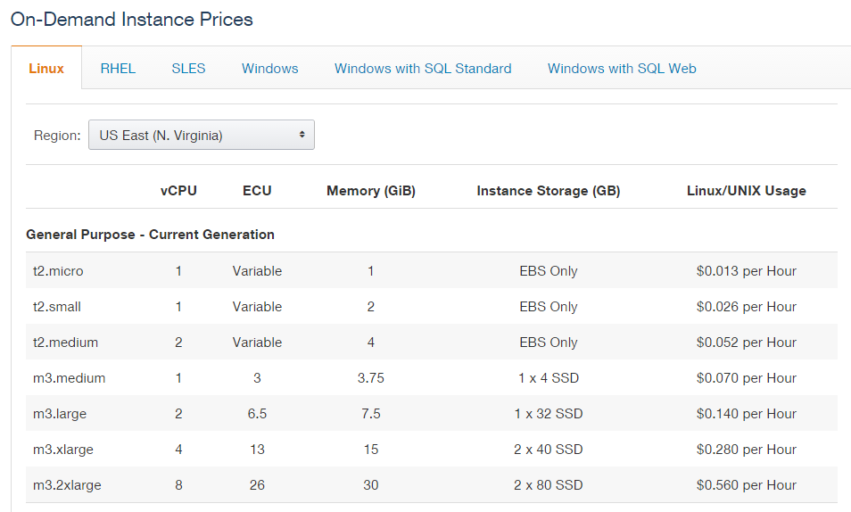

Slide 7
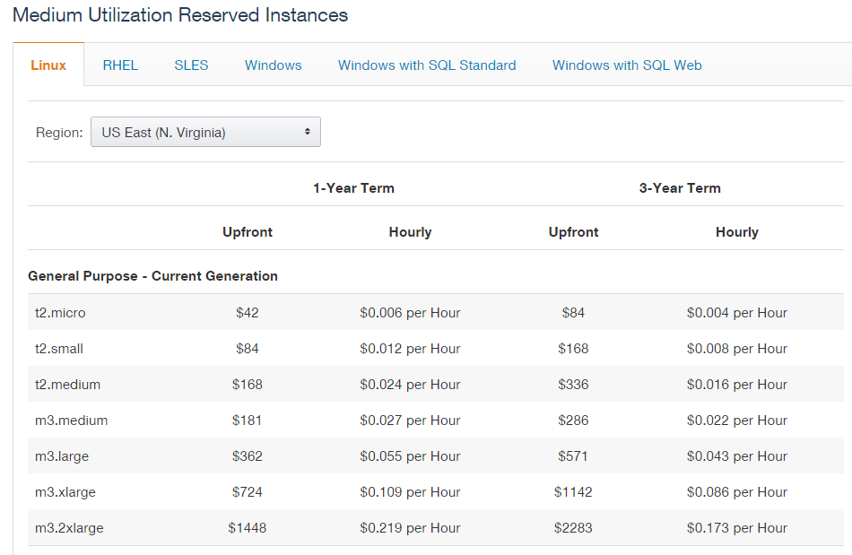

Slide 8
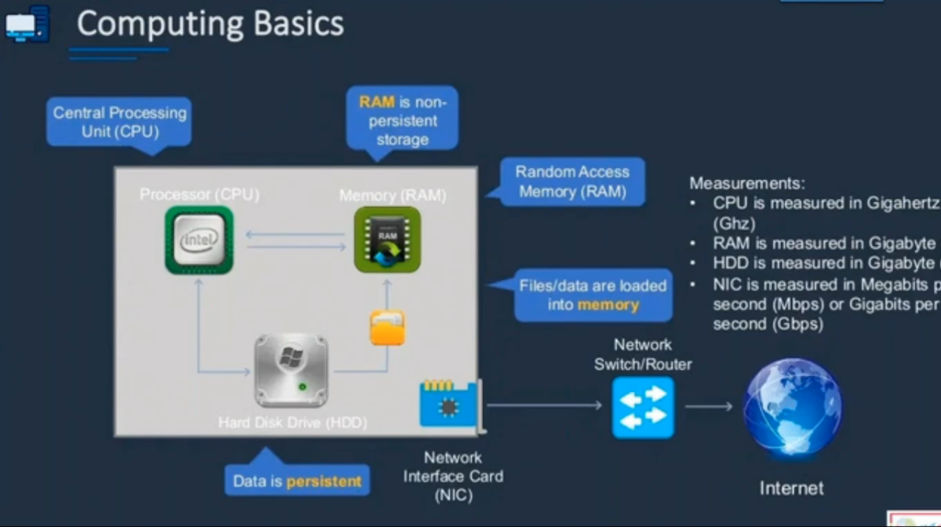

Slide 9
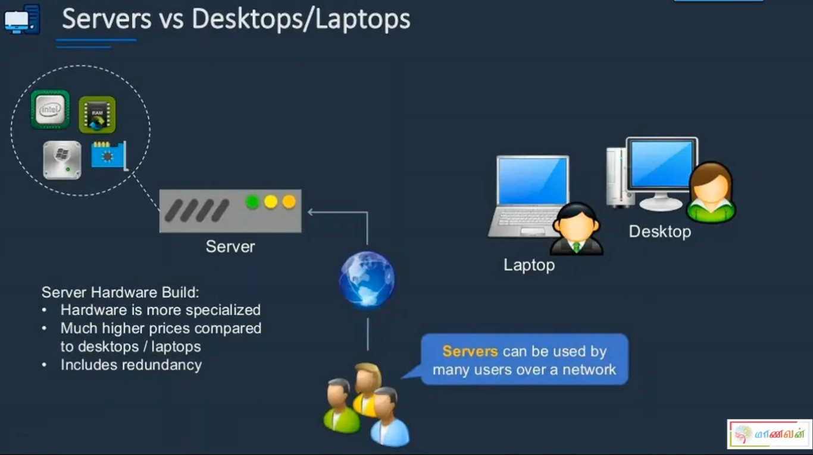


Slide 10
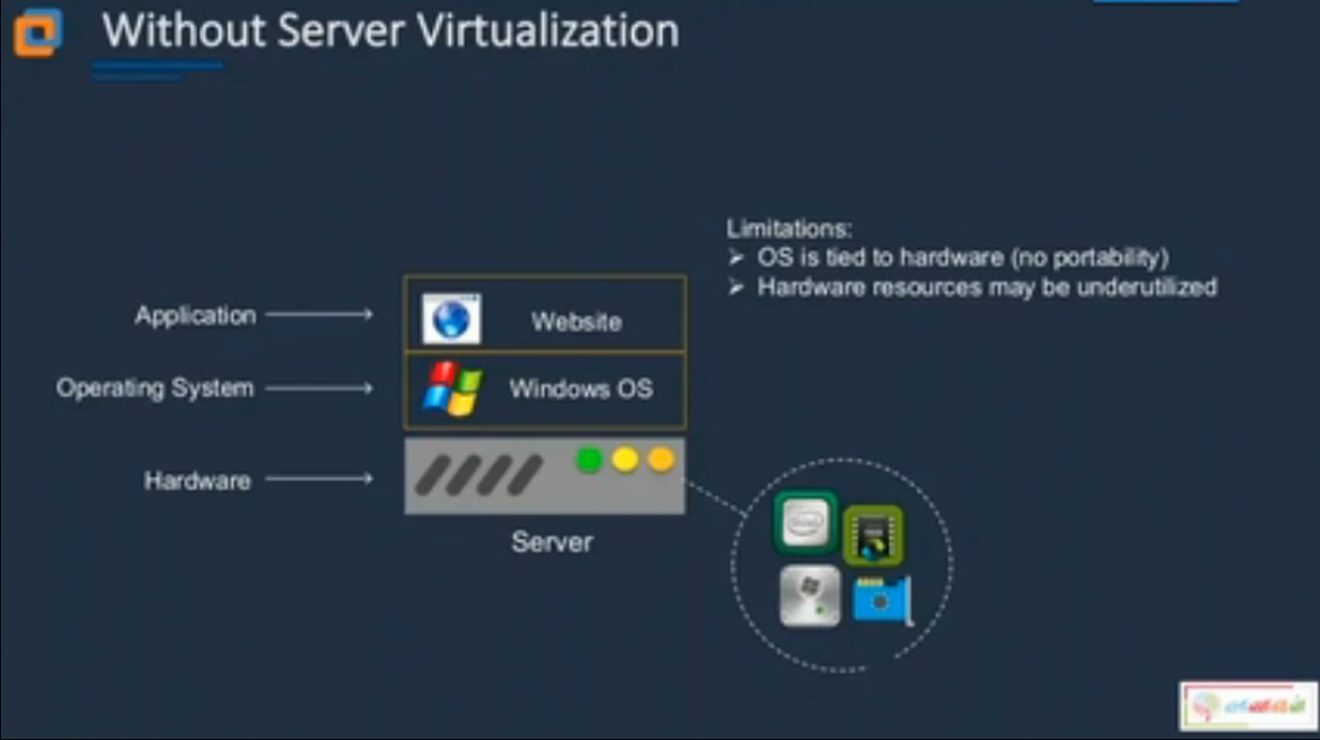


Slide 11
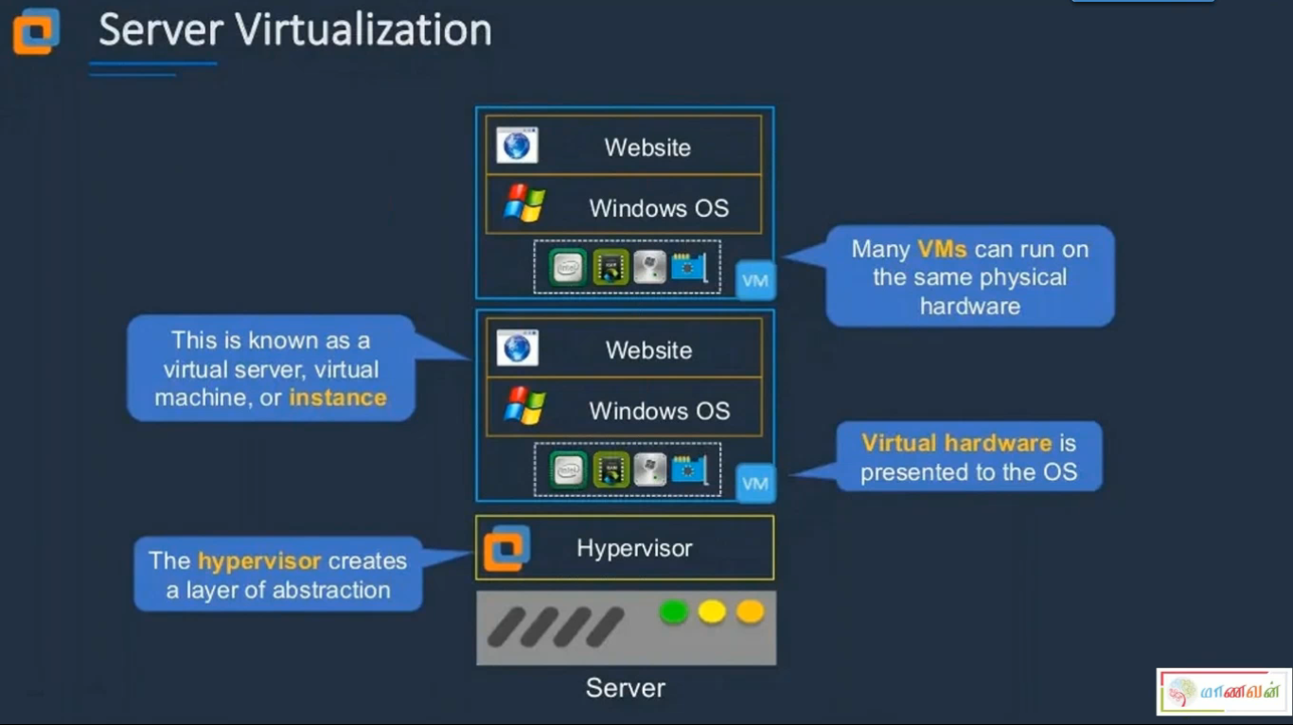


Slide 12
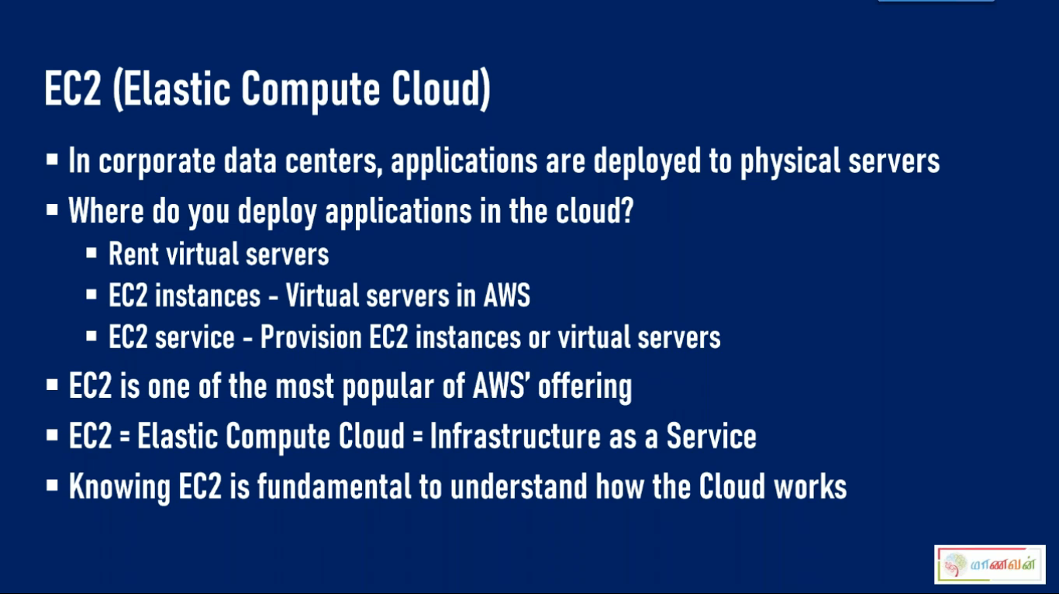

Slide 13
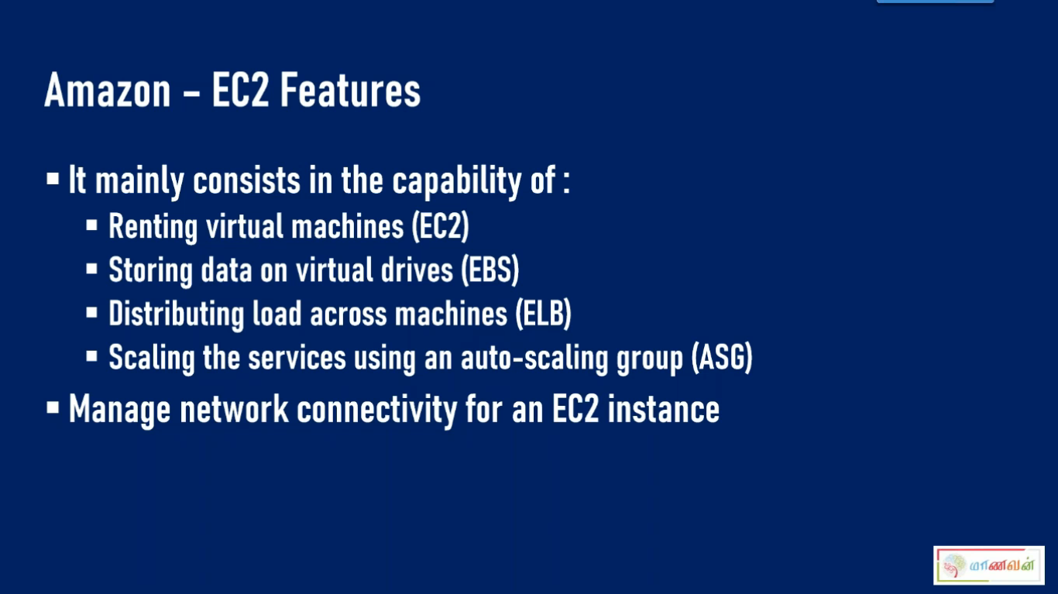

Slide 14
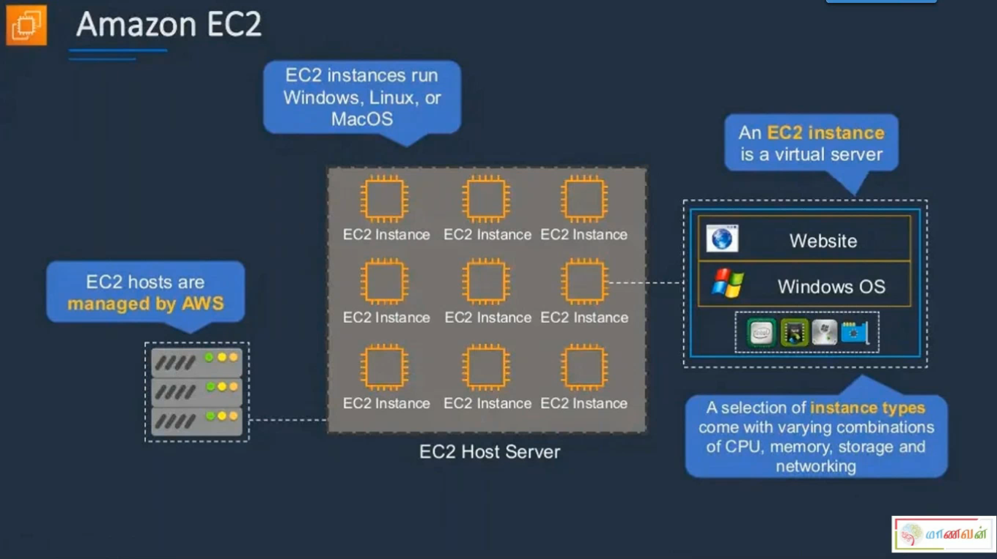


Slide 15
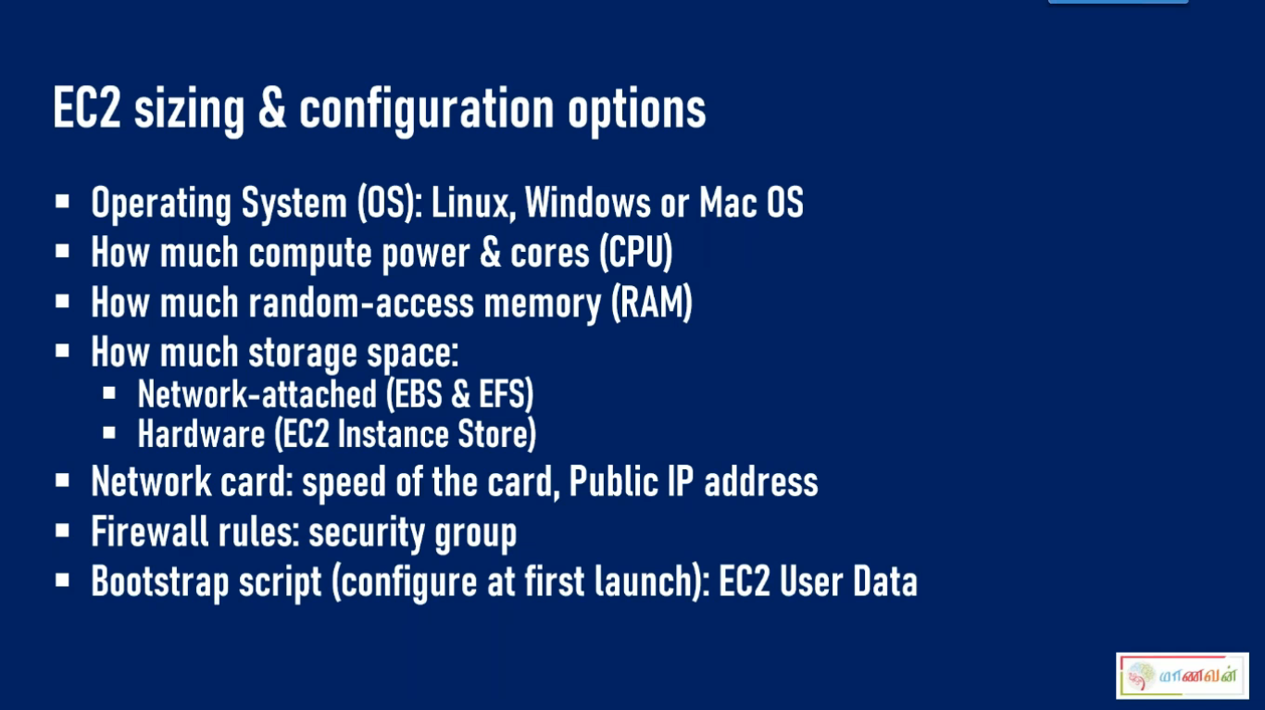

Slide 16
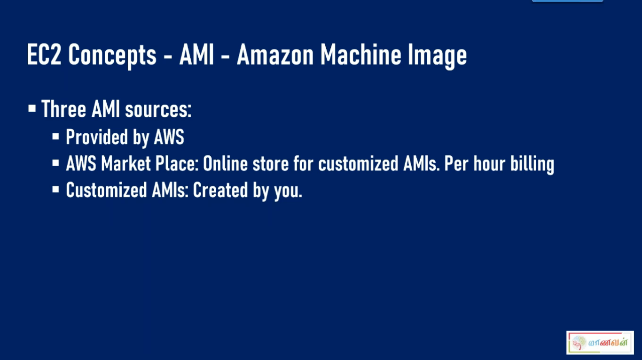

Slide 17


SCALABLITY &
HIGH AVAILABLITY

Slide 18
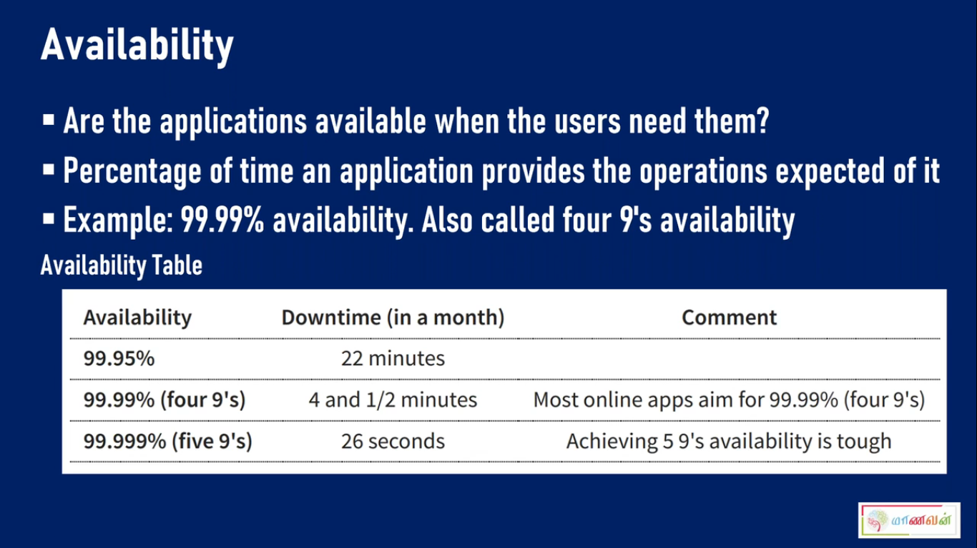

v

Slide 19
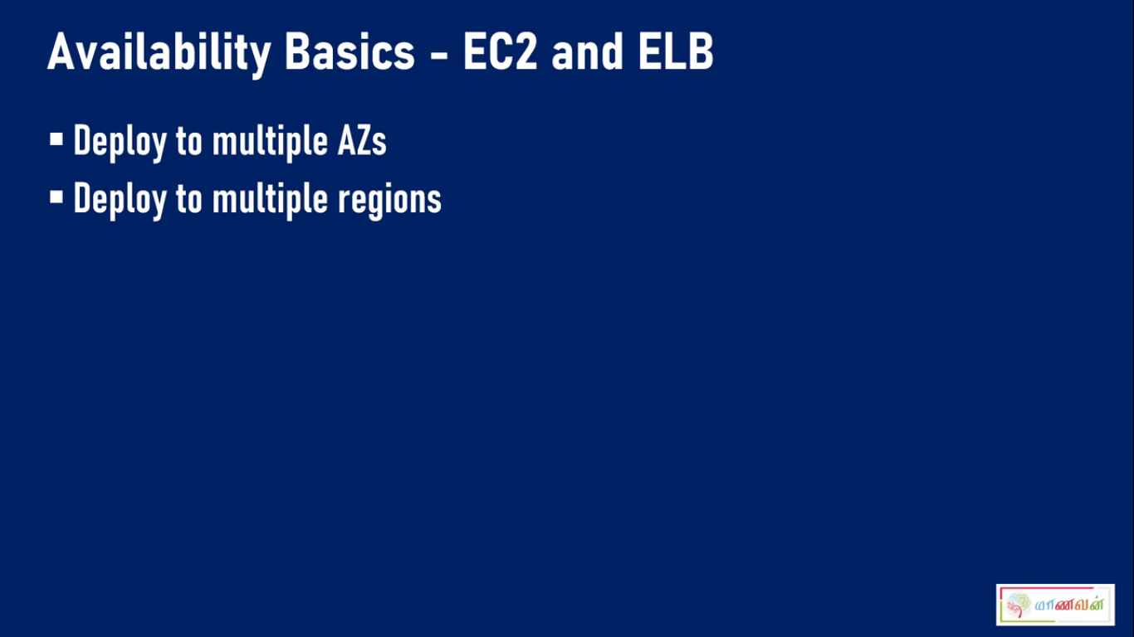

Slide 20
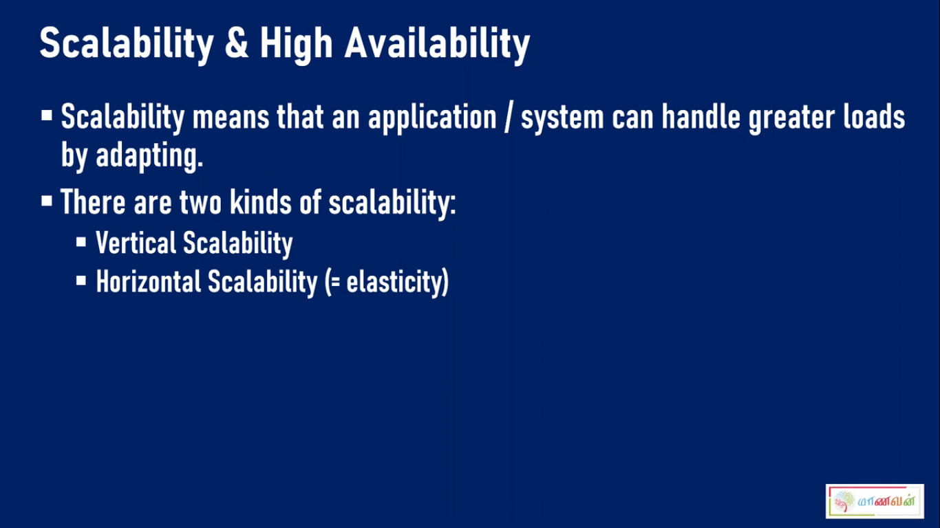

Slide 21
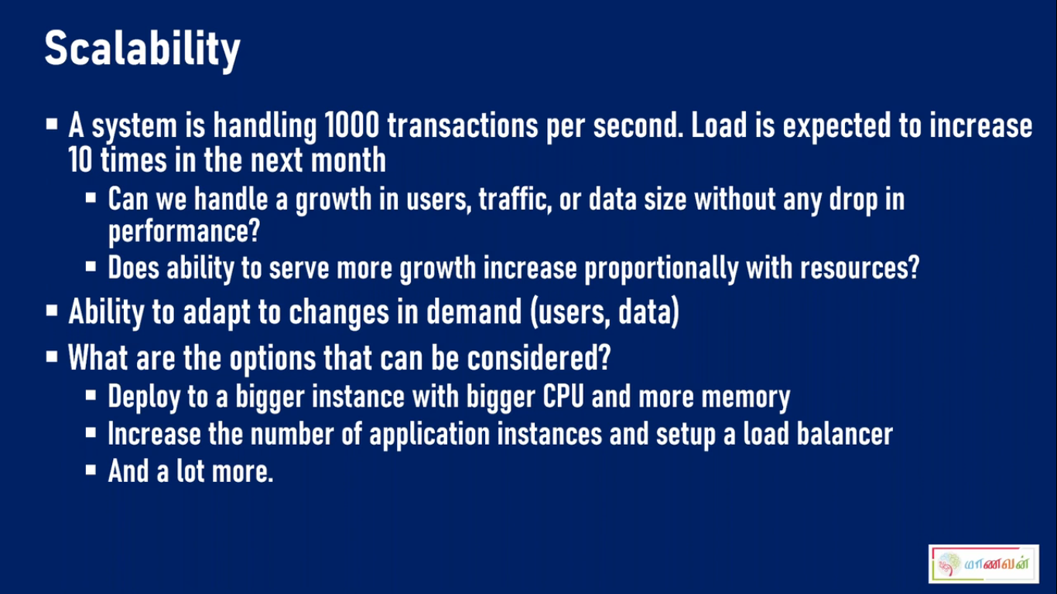

Slide 22
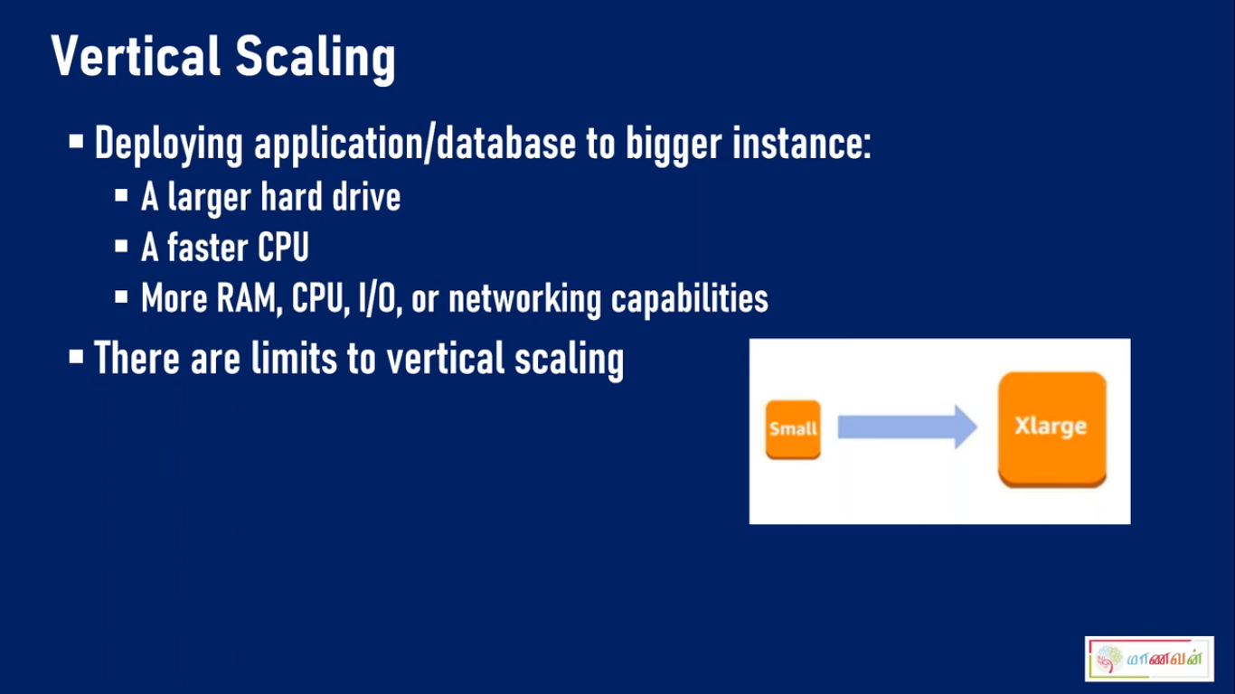

Slide 23
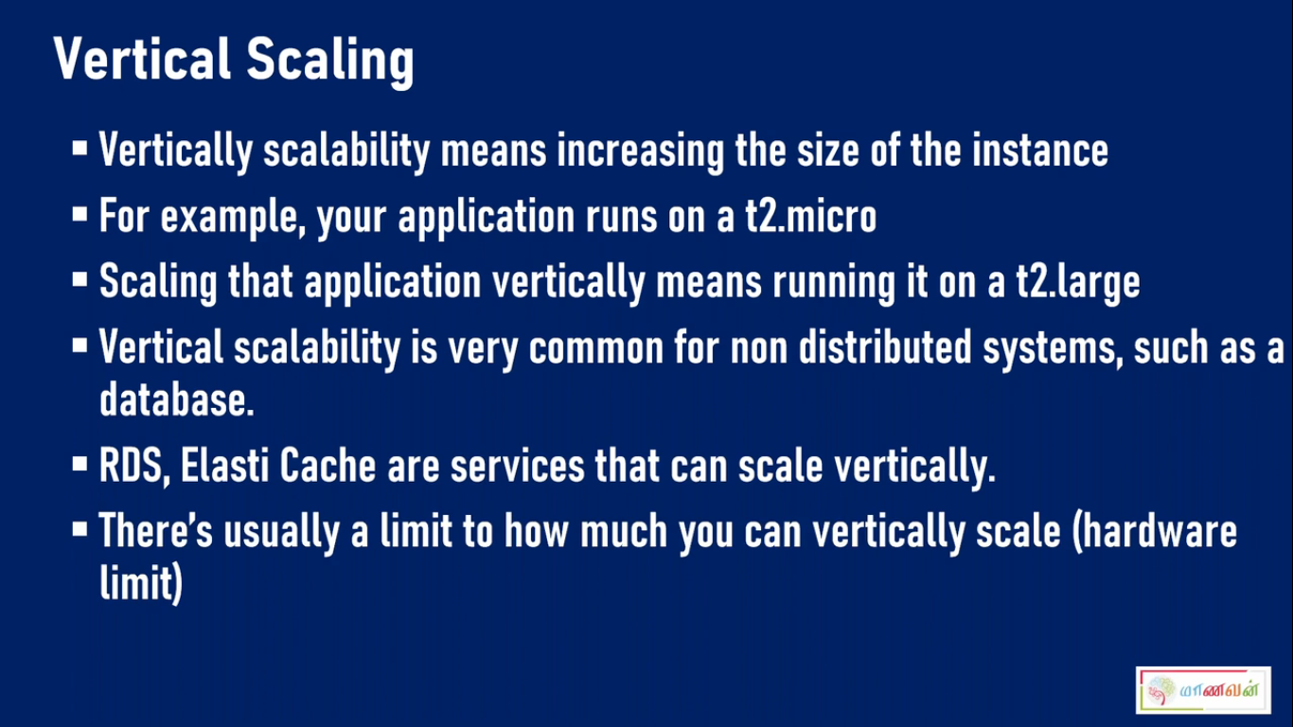

Slide 24
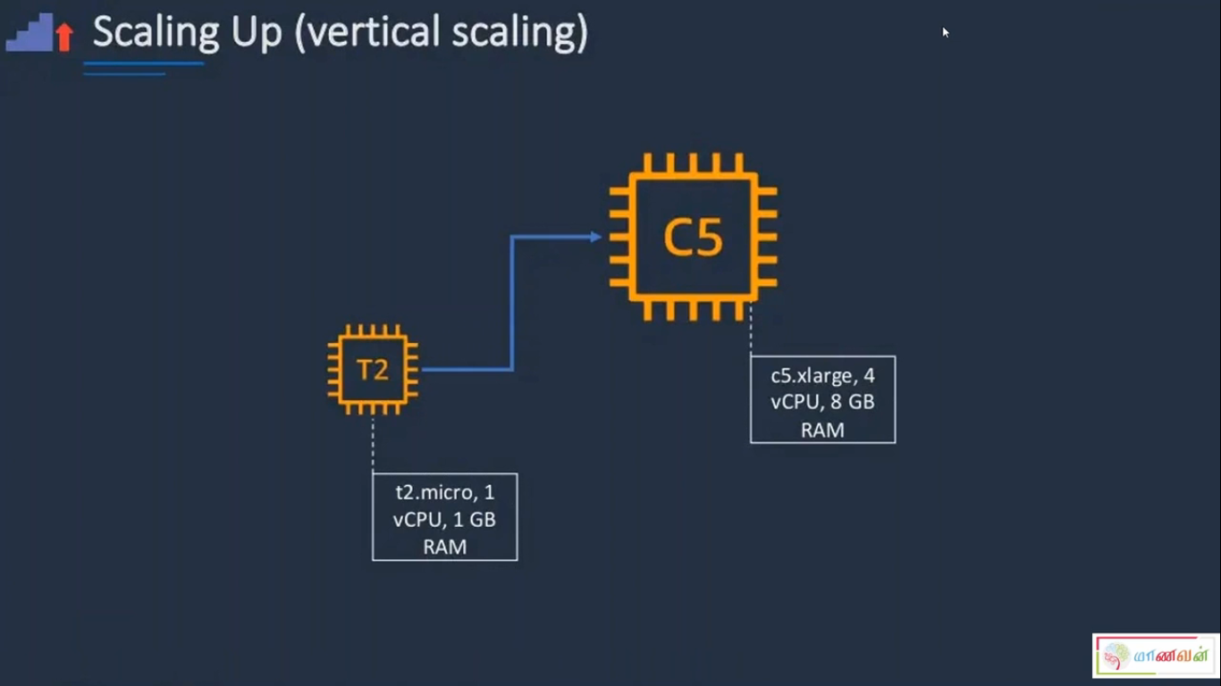

Slide 25
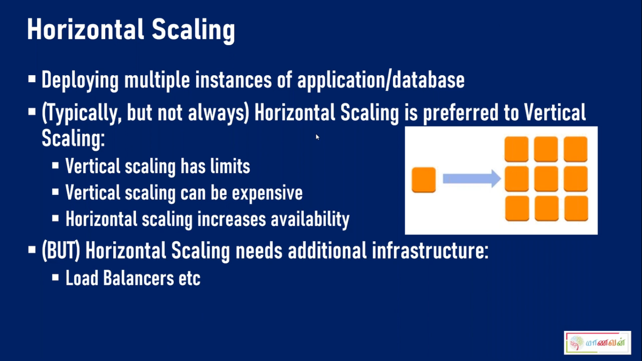

Slide 26
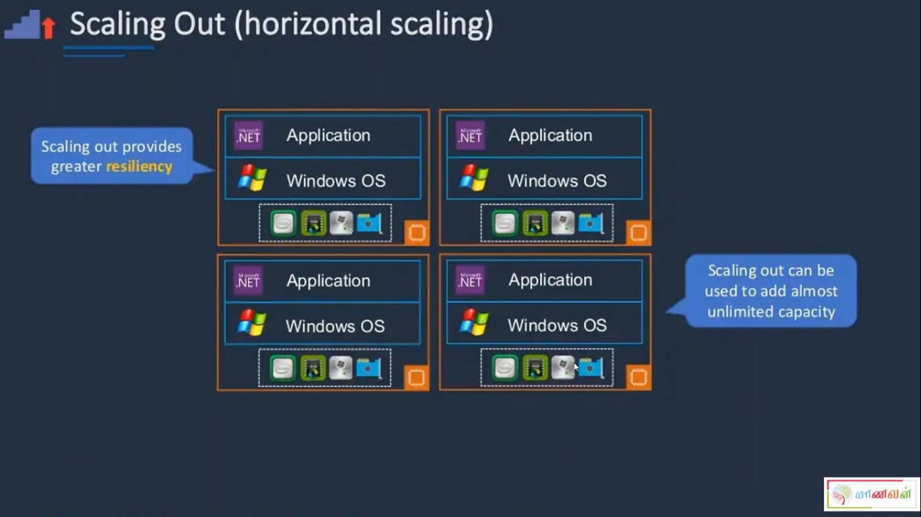

Slide 27
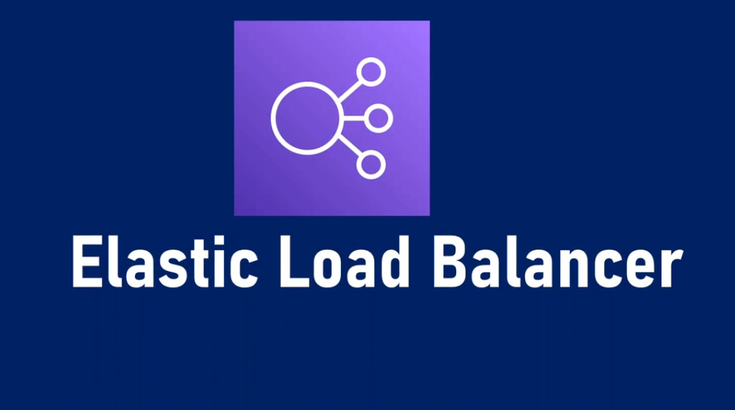

Slide 28
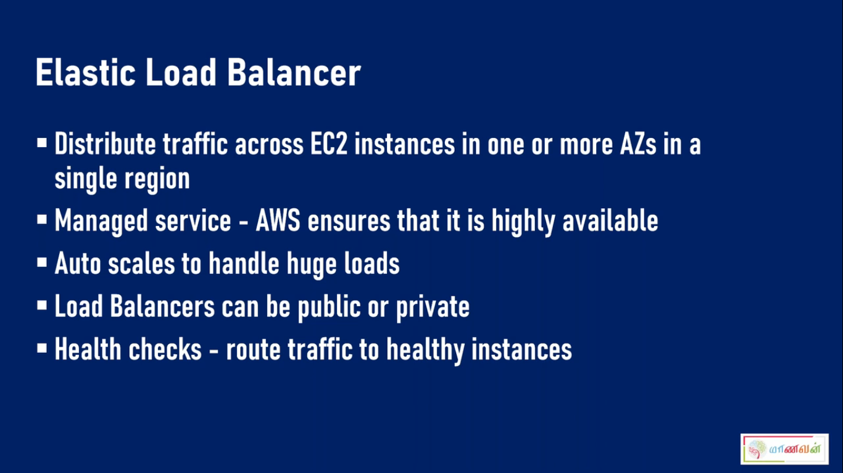

Slide 29
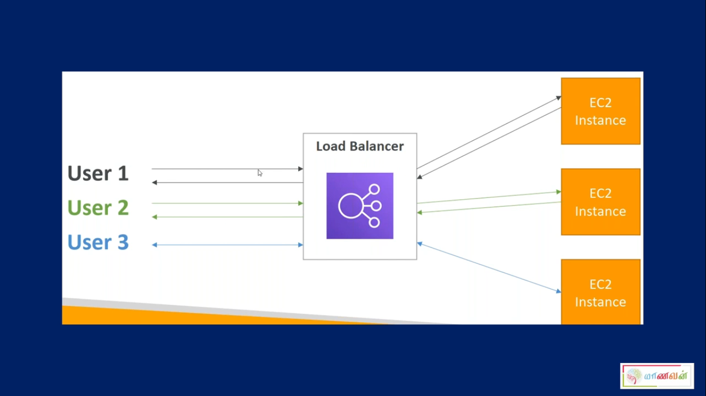


Slide 30
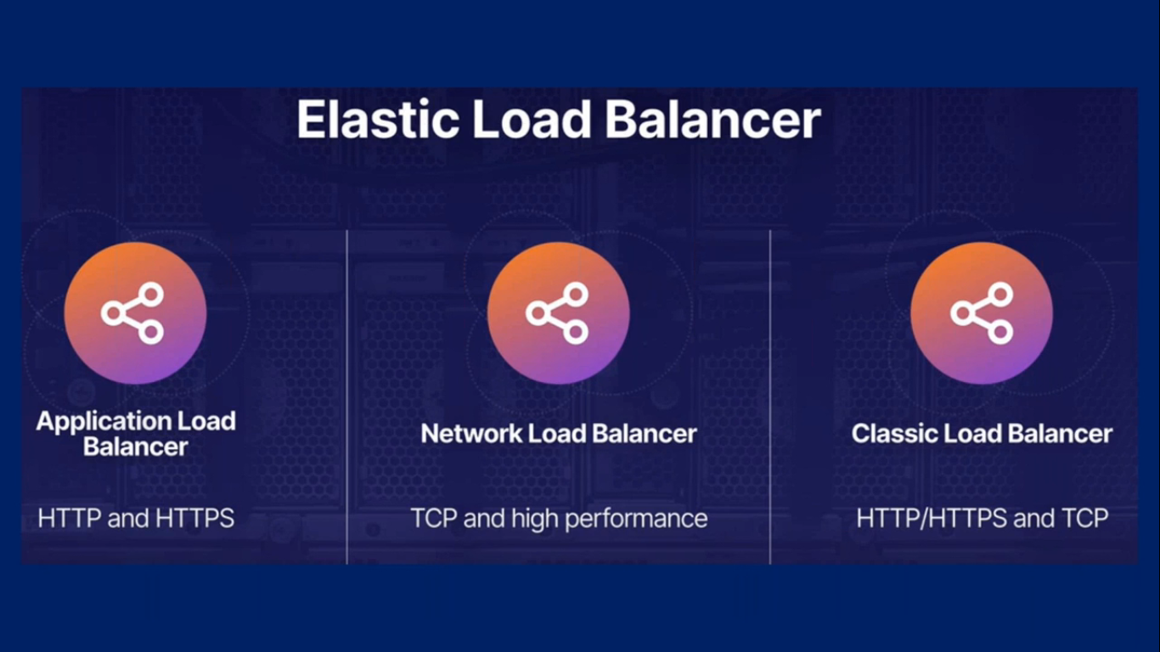

Slide 31
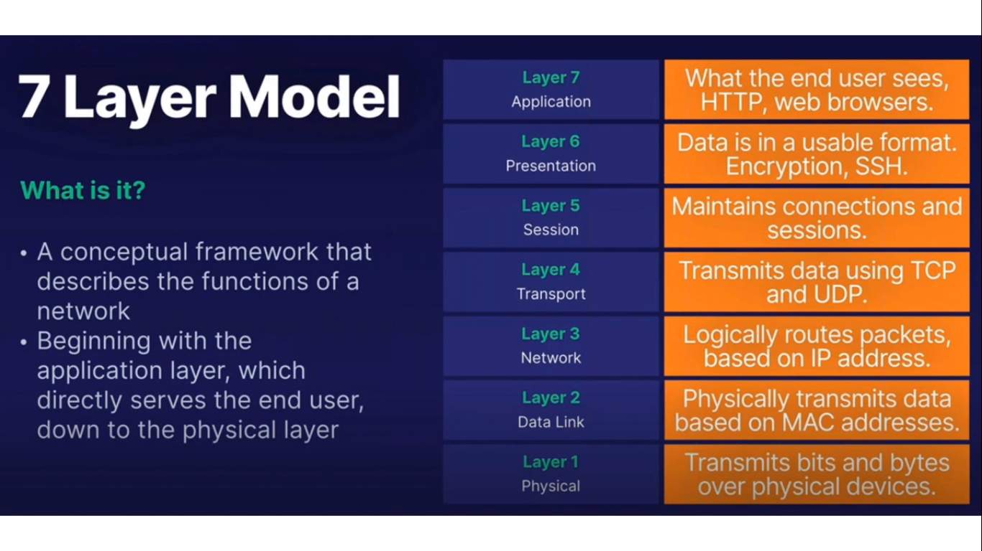

Slide 32
Autoscaling

Slide 33
AWS Auto Scaling
Auto-scaling is a technique that automatically adjust the amount of source by launching and terminating EC2 instances based on actual load demand

Slide 34
Why we use Auto scaling
Save money by only using instances when you need them.
Scale to accommodate expected and unexpected loads.
Replace unhealthy servers with healthy ones.

Slide 35
Auto Scaling Components
Launch Load balancer
Target groups
Auto scaling groups
Cloud Watch alarms

Slide 36
Advantages of Auto scaling
From user perspective
From cloud provider perspective

